Slide 1

Identification and evaluation of fragmentation pathways of PDE-5 inhibitor analogues using LC-QTOF-MS
Rovshen Charygeldiyev & Jeroen Kooistra
Students at the University of Amsterdam / Vrije Universiteit Amsterdam
Mass spectrometry 2016
Jung-Ah Do, Eunyoung Noh et al.
Analytical Science & Technology. 2015. Aug, 28(4): 278-287

Slide 2

Phosphodiesterase type 5 (PDE-5) inhibitor analogues
Illegal undeclared adulterants against erectile disorders
Identification of 58 analogues by (LC-QTOF-MS/MS)
Analogues devided in 5 groups;
tadalafil,
sildenafil,
hongdenafil,
vardenafil
other analogues
Mechanisms were set up for each group
Mechanisms can help withthe identification of unknown compounds

Slide 3
Tadalafil (C₂₂H₁₉N₃O₄), Mass – 389.1376

Slide 4
Sildenafil (C₂₂H₃₀N₆O₄S), mass – 474.2049

Slide 5
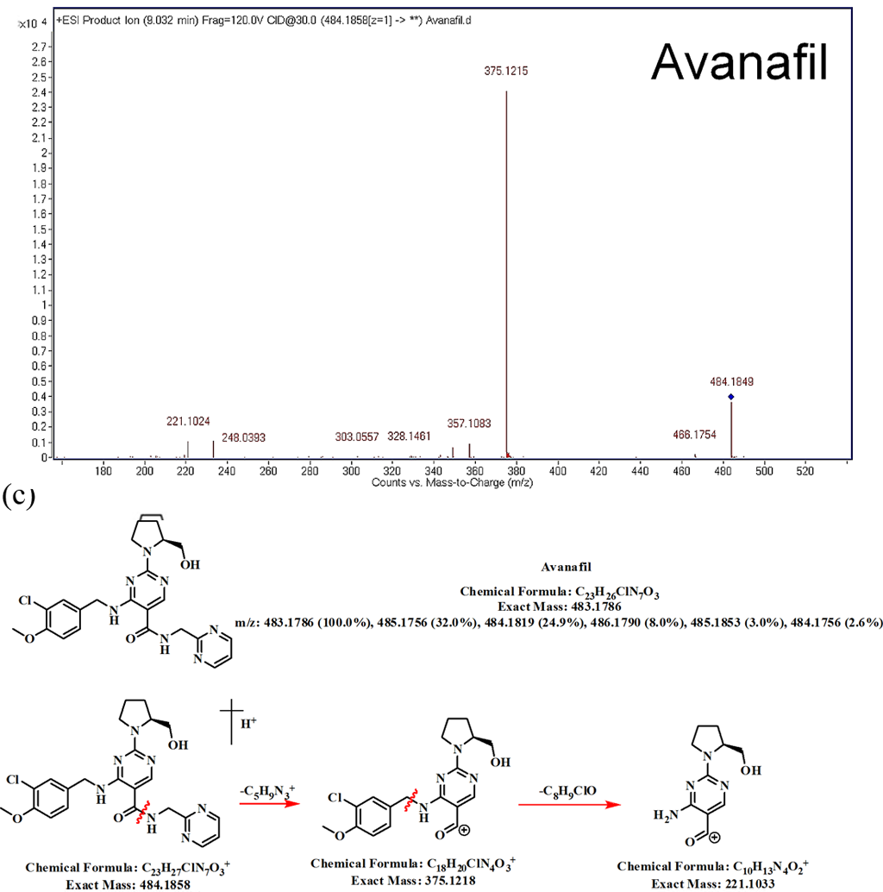
Avanafil

Slide 6
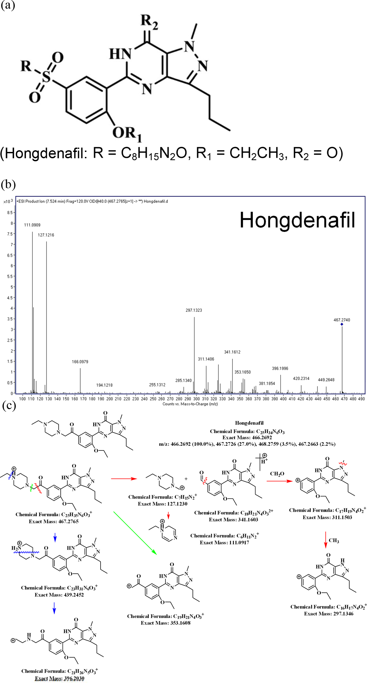
Hongdenafil

Slide 7
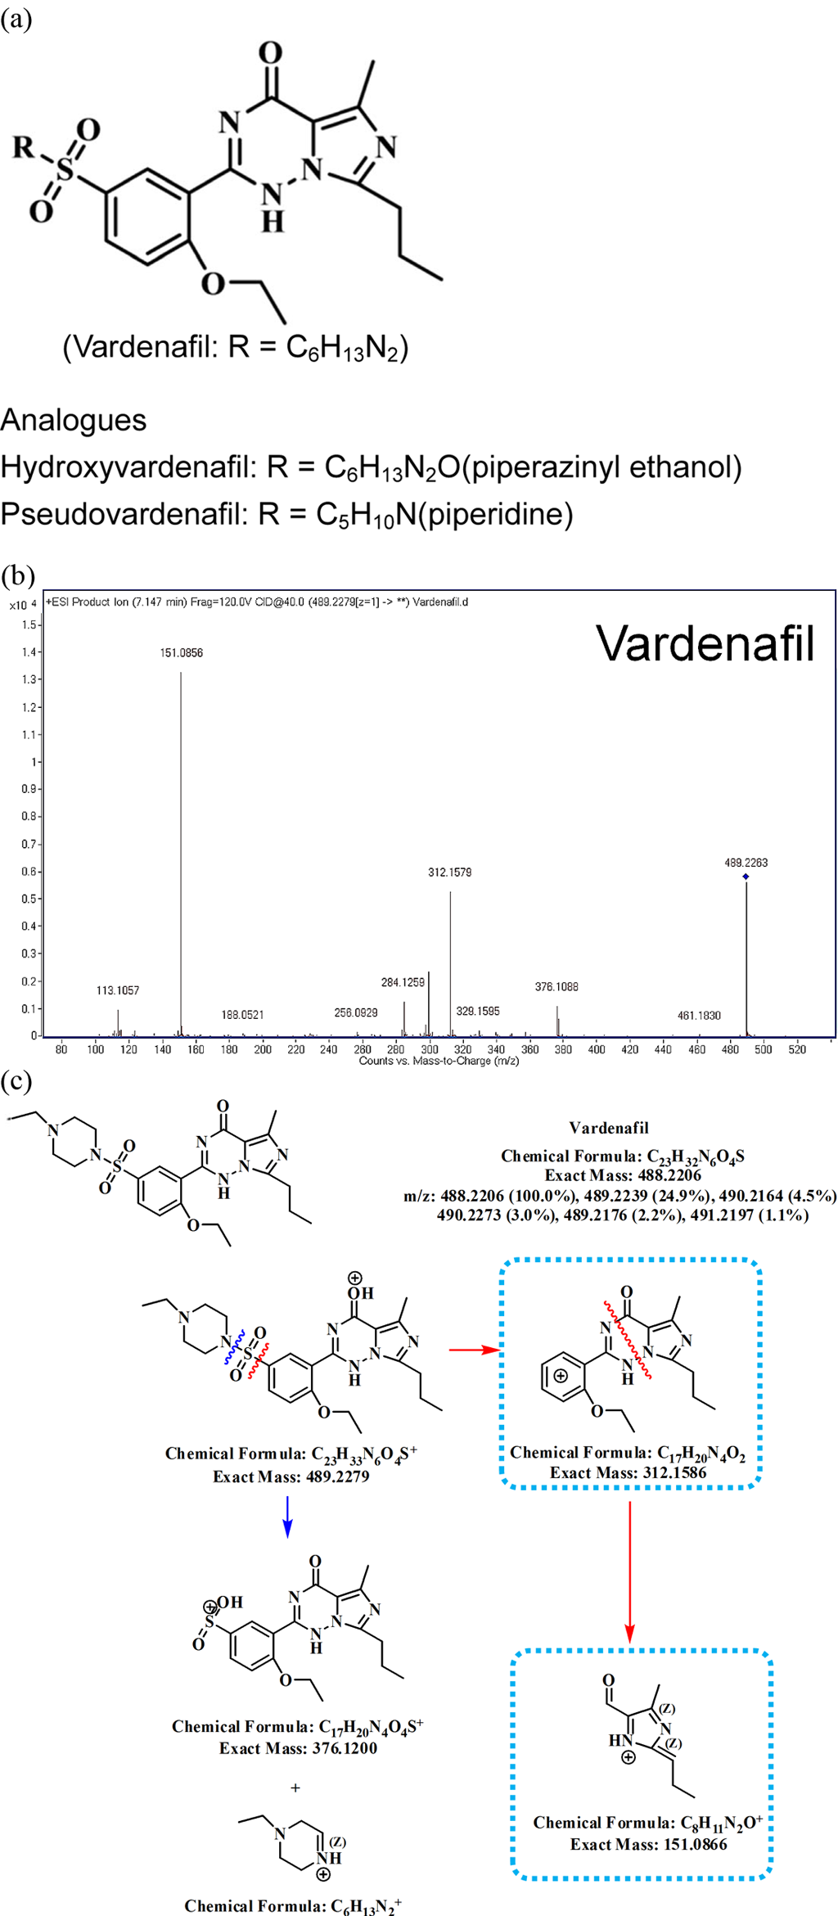
Vardenafil

Slide 8


Questions?

